Slide 1
PolypNet: An Attention Based Shallow Deep Learning Model for Colorectal Polyp Image Classification

Slide 2
Proposed by: Md. Saiful Islam MC-201104R M.Sc. in CSE Department of Computer Science and Engineering International Islamic University Chittagong (IIUC) | Supervised by Md. Khaliluzzaman Associate Professor Department of Computer Science and Engineering International Islamic University Chittagong (IIUC)

Slide 3
Content
Introduction
Motivation
Problem Statement
Literature Review
Research Gap
Research Objective
Methodology
Result
Discussion
Contribution
Conclusion
References

Slide 4
Introduction
Colorectal Cancer (CRC) Impact: CRC is a leading cause of cancer deaths, emphasizing the importance of early detection.
Role of Deep Learning: Deep learning technologies assist in identifying colon polyps during colonoscopies, which can help reduce CRC mortality.
Model Limitations: Current deep learning models face challenges with overfitting and generalization to new datasets.
Research Focus: Our research investigates advanced models for polyp images, revealing limitations in accuracy.
Proposed Solution: We propose a shallow CNN with a self-attention mechanism to enhance classification accuracy

Slide 5
Motivation
Consequences of Missing Polyps: Undetected polyps can result in advanced CRC, making reliable detection systems essential.
Enhancing Detection: Focused on improving polyp identification, surface characterization, and segmentation through deep learning for greater reliability and consistency.
Promise of AI: Deep learning and AI have proved effective in various fields, and applying these technologies to CRC detection could significantly enhance accuracy.
Impact on Lives: Improving polyp detection with advanced technology can lead to earlier interventions, potentially saving numerous lives.

Slide 6
Problem Statement
Limitations of Current Methods: Existing detection techniques are not reliable; traditional colonoscopy is time-consuming and error-prone, particularly for small, hidden polyps.
Need for Automation: There is a pressing need for improved, automated solutions for polyp detection.
Role of Deep Learning: Deep learning models, such as UNet and LinkNet, can enhance polyp detection & classification efficiency and accuracy.
Proposed Solution: Utilizing these models can streamline the classification process, leading to faster and more reliable outcomes.

Slide 7
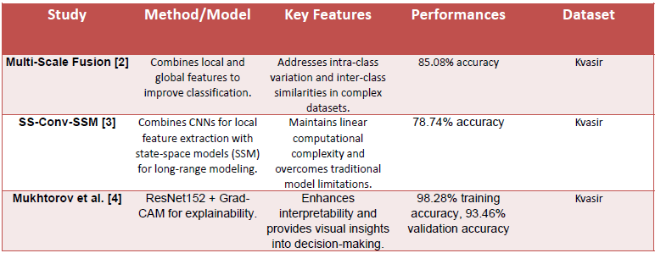
Literature Review

Slide 8
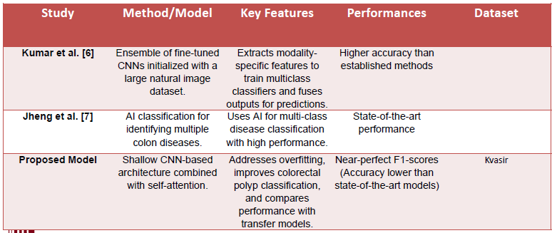
Literature Review

Slide 9
Research Gap
Generalization Issues: Many current deep learning models for classifying colorectal polyps do not work well when applied to new data outside of the small datasets they were trained on. This leads to overfitting, making them less reliable in real-life situations.
Challenge with Polyp Features: Existing methods often struggle to accurately identify small or hidden polyps and don’t effectively describe their surface characteristics. There is a need for better techniques that can reliably improve detection.
Ethical Considerations: There is not enough focus on patient privacy and ethical issues when using machine learning for CRC classification. Developing clear ethical guidelines is essential for these technologies to be used safely in medical practice.

Slide 10
Objective
The objective of the thesis paper is
• To design PolypNet as a shallow Convolutional Neural Network (CNN) enhanced with a self-attention mechanism.
• To compare the performance of PolypNet against established models like VGG16, ResNet50, DenseNetv3, and MobileNetv3.
• To address the limitations of existing models, specifically overfitting and poor generalization on small datasets.
• To improve the classification of colorectal polyps.

Slide 11
Methodology
Kvasir v1 Dataset:

Slide 12
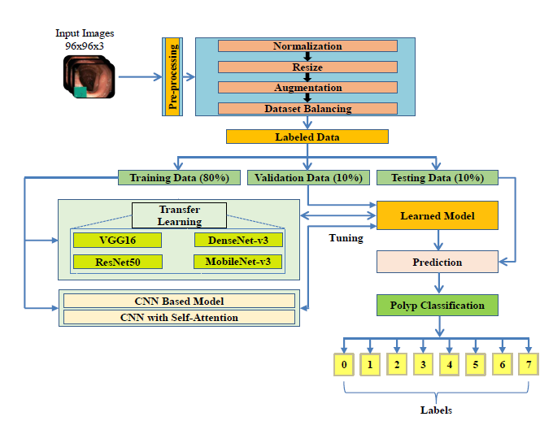
Methodology(Cont.)

Slide 13
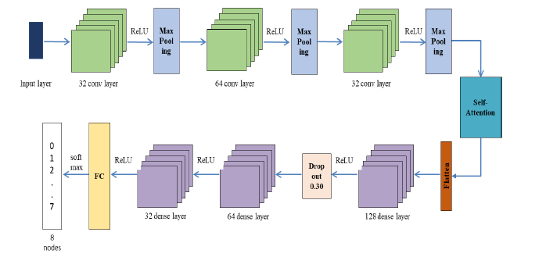
Methodology(Cont.)

Slide 14
Result Analysis
Accuracy of state-of-the art Pre-trained CNN models on Kvasir-dataset
Model Name | Train Accuracy | Test Accuracy
VGG16 | 100% | 84%
ResNet50 | 100% | 86%
DenseNet v3 | 98% | 74%
MobileNet v3 | 100% | 69%

Slide 15
Result Analysis(Cont.)
We created 10 model by changing the layers.
Then we implemented our model on the dataset.
Result Of Proposed Models 96 x 96 x 3(Without Augmentation):
Model | Train Accuracy | Test Accuracy
NewNet1 | 0.9941 | 0.71
NewNet2 | 0.9937 | 0.765
NewNet3 | 0.9847 | 0.7325
NewNet4 | 0.995 | 0.7625
NewNet5 | 0.9903 | 0.74
NewNet6 | 0.9803 | 0.7525
NewNet7 | 0.9878 | 0.775
NewNet8 | 0.9897 | 0.75
NewNet9 | 0.9859 | 0.71
NewNet10 | 0.9203 | 0.7232

Slide 16
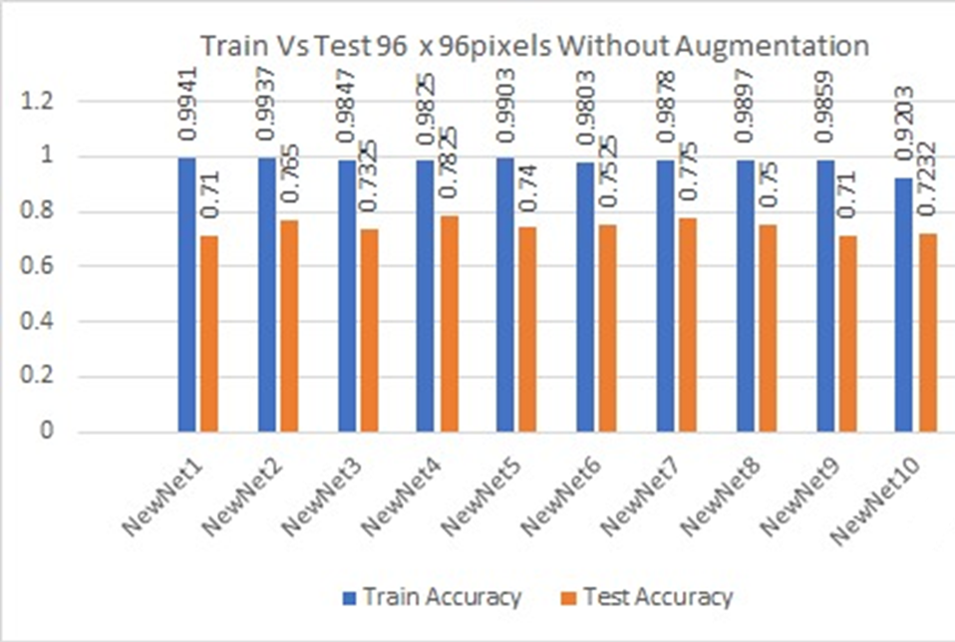
Result Analysis(Cont.)
Result Of Proposed Models 96 x 96 x 3(Without Augmentation):

Slide 17
Result Analysis(Cont.)
We observed that our model produced an overfit result after fitting it to the data set.
This may occur for the short amount of our data.
So we then augmented our data then again implement our model on this augmented data.

Slide 18
Result Analysis(Cont.)
Result Of Proposed Models 96 x 96 x 3(With Augmentation):
Model | Train Accuracy | Test Accuracy
NewNet1 | 0.7681 | 0.7775
NewNet2 | 0.7694 | 0.775
NewNet3 | 0.7481 | 0.7525
NewNet4 | 0.7366 | 0.7525
NewNet5 | 0.7713 | 0.75
NewNet6 | 0.7259 | 0.705
NewNet7 | 0.7769 | 0.77
NewNet8 | 0.7291 | 0.745
NewNet9 | 0.7806 | 0.7525
NewNet10 | 0.6859 | 0.7075

Slide 19
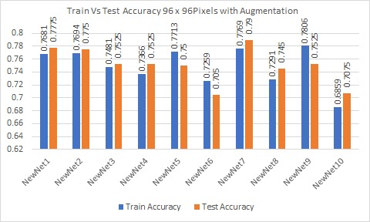
Result Analysis(Cont.)
Result Of Proposed Models 96 x 96 x 3(With Augmentation):

Slide 20
Result Analysis(Cont.)
After augmentation we overcome the overfitting issue.
The best model among our proposed models is NewNet9.
But we face another issue. Our best model has low accuracy.
For overcome this accuracy problem we add self-attention in our best NewNet9 model.
Model | Train Accuracy | Test Accuracy
NewNet9 | 0.78 | 0.7850
PolypNet (100 epochs) | 0.82 | 0.82
PolypNet (200 epochs) | 0.88 | 0.86

Slide 21
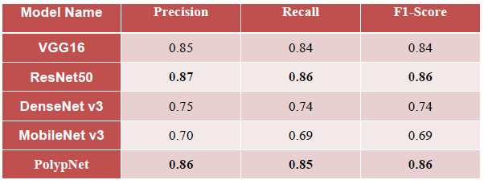
Result Analysis(Cont.)
Accuracy of state-of-the art Pre-trained CNN models on Kvasir-dataset

Slide 22
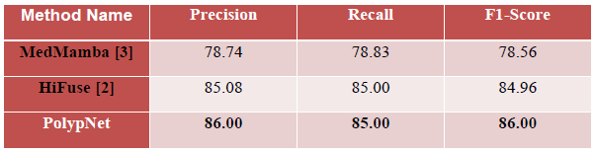
Result Analysis(Cont.)
Compare with latest work

Slide 23
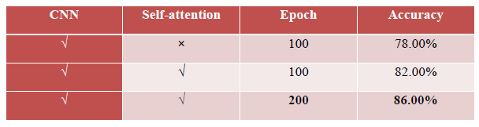
Result Analysis(Cont.)
Ablation study

Slide 24
Contribution
Introduction of PolypNet, a shallow CNN model with a self-attention mechanism for improved colorectal polyp classification and overcoming the overfitting problem.
Comparison of PolypNet with established CNN-based models (VGG16, ResNet50, DenseNetv3, MobileNetv3) to justify the effectiveness of the proposed method.
PolypNet achieves a precision score of 0.86, matching ResNet50 and outperforming other models, demonstrating its effectiveness for automated polyp classification.

Slide 25
Conclusion
Introduced a shallow CNN-based model with self-attention to address overfitting on small datasets.
Achieved near-perfect F1-scores for colorectal polyp classification on the Kvasir-v1 dataset.
Outperformed existing polyp classification methods but leaves room for accuracy improvement.
Future plans include developing hybrid architectures for enhanced diagnostic accuracy.
Aims to create user-friendly applications for easier clinical use, particularly in rural and underdeveloped areas.

Slide 26
References
[1] F. Bray, M. Laversanne, E. Weiderpass, and I. Soerjomataram, "The ever‐increasing importance of cancer as a leading cause of premature death worldwide," Cancer, vol. 127, no.
16, pp. 3029-3030, 2021, doi: 10.1002/cncr.33587.
[2] X. Huo, G. Sun, S. Tian, Y. Wang, L. Yu, J. Long, W. Zhang, and A. Li, "HiFuse: Hierarchical multi-scale feature fusion network for medical image classification," Biomedical Signal
Processing and Control, vol. 87, p. 105534, 2024.
[3] Y. Yue and Z. Li, "Medmamba: Vision mamba for medical image classification," arXiv preprint arXiv:2403.03849, 2024.
[4] D. Mukhtorov, M. Rakhmonova, S. Muksimova, and Y. I. Cho, "Endoscopic image classification based on explainable deep learning," Sensors, vol. 23, no. 6, p. 3176, 2023.
[5] Y. Yu, H. Lin, J. Meng, X. Wei, H. Guo, and Z. Zhao, "Deep transfer learning for modality classification of medical images," Information, vol. 8, no. 3, p. 91, 2017.
[6] A. Kumar, J. Kim, D. Lyndon, M. Fulham, and D. Feng, "An ensemble of fine-tuned convolutional neural networks for medical image classification," IEEE Journal of Biomedical and
Health Informatics, vol. 21, no. 1, pp. 31-40, 2016.
[7] Y. C. Jheng, Y. P. Wang, H. E. Lin, K. Y. Sung, Y. C. Chu, H. S. Wang, J. K. Jiang, M. C. Hou, F. Y. Lee, and C. L. Lu, "A novel machine learning-based algorithm to identify and classify
lesions and anatomical landmarks in colonoscopy images," Surgical Endoscopy, vol. 36, pp. 640-650, 2022.
[8] T. Hirasawa, K. Aoyama, T. Tanimoto, S. Ishihara, S. Shichijo, T. Ozawa, T. Ohnishi, M. Fujishiro, K. Matsuo, J. Fujisaki, and T. Tada, "Application of artificial intelligence using a
convolutional neural network for detecting gastric cancer in endoscopic images," Gastric Cancer, vol. 21, pp. 653-660, 2018.
[9] A. Vaswani, N. Shazeer, N. Parmar, J. Uszkoreit, L. Jones, A. N. Gomez, Ł. Kaiser, and I. Polosukhin, "Attention is all you need," Advances in Neural Information Processing Systems,
vol. 30, 2017.
[10] K. Simonyan and A. Zisserman, "Very deep convolutional networks for large-scale image recognition," arXiv preprint arXiv:1409.1556, 2014.
[11] K. He, X. Zhang, S. Ren, and J. Sun, "Deep residual learning for image recognition," in Proceedings of the IEEE Conference on Computer Vision and Pattern Recognition, 2016, pp.
770-778.
[12] G. Huang, Z. Liu, L. van der Maaten, and K. Q. Weinberger, "Densely connected convolutional networks," in Proceedings of the IEEE Conference on Computer Vision and Pattern
Recognition, 2017, pp. 4700-4708.
[13] A. Howard, M. Sandler, G. Chu, L. C. Chen, B. Chen, M. Tan, W. Wang, Y. Zhu, R. Pang, V. Vasudevan, and Q. V. Le, "Searching for MobileNetV3," in Proceedings of the IEEE/CVF
International Conference on Computer Vision, 2019, pp. 1314-1324.
[14] K. Pogorelov, K. R. Randel, C. Griwodz, S. L. Eskeland, T. de Lange, D. Johansen, C. Spampinato, D. T. Dang-Nguyen, M. Lux, P. T. Schmidt, and M. Riegler, "Kvasir: A multi-class
image dataset for computer aided gastrointestinal disease detection," in Proceedings of the 8th ACM on Multimedia Systems Conference, 2017, pp. 164-169.

